Slide 1
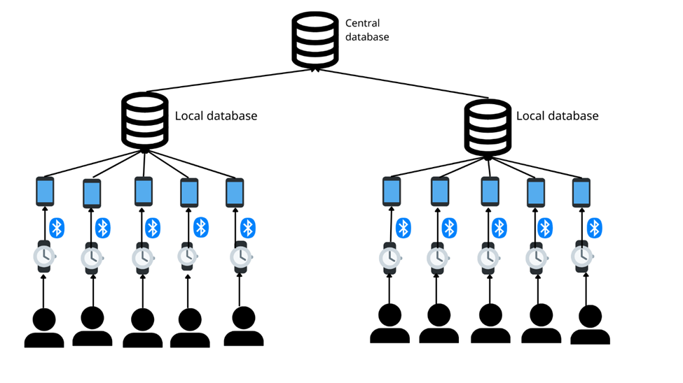
Design idea/concept 4 – Digital Healthcare System
Learning issue/problem
The problem related to Umuwa health system and healthcare
Design outline

Slide 2
Design idea/concept 4 – Digital Healthcare System
Design benefits
Accessibility
Affordability and maintenance
No impact on health and environment
Improving the quality of the health service
Improve the health and living standard of citizens in Umuwa

Slide 3
Design idea/concept 4 – Digital Healthcare System
Estimation of the design budget
Software | Unit Cost | Quantity | Total Cost
Creating the application | 15000 | 1 | 18000
Creating and managing the database | 5000 | 3 | 15000
Software
Hardware
Hardware | Unit Cost | Quantity | Total Cost
Phone | 600 | 100 | 60000
Watch | 700 | 100 | 70000
 | Cost per hour | Hour required | Total Cost
Workforce Training | 200 | 8 | 1600
Testing | 300 | 10 | 3000
Connecting (1 time) | 2000 | 1 | 2000
Process

